Slide 1
PATH PLANNING IN ROBOTICS
ROBOTICS UNDER THE GUIDANCE OF DR. UPMA JAIN ASSISTANT PROFESSOR GRAPHIC ERA (DEEMED TO BE UNIVERSITY)

Slide 2

PROBLEM STATEMENT
Though efficient in static environments, the representation and path planning algorithms like A* and Dijkstra are not adept at handling the vagaries of changing terrains. Therefore, there is a lack of more suitable and effective methods for enabling the path planning of autonomous robots in such situations.

Slide 3

LITERARY REVIEW
Improved Particle Swarm Optimisation: In this paper, an improved version of the traditional PSO was implemented. The inertia of the particles is varied throughout the iterations, the values also changed based upon the inertia weight.
Improved PSO-GWO Algorithm: In this paper, Grey Wolf optimisation was used in combination with improved PSO. The modification of inertial weight after each iteration is adaptive based on the current and the of previous iteration.
Particle Swarm Optimization (PSO) : An evolutionary algorithm that has been applied to many different engineering and technological problems with considerable success. It has been continually modified trying to improve its convergence properties.

Slide 4

OBJECTIVE
Optimal Path Discovery: To enhance robotic navigation by determining the most efficient route in various environments. This involves employing advanced path planning algorithms that calculate paths focusing on minimizing both travel time and distance.
Collision avoidance: To steer clear of any obstacles present in the environment between the initial and target coordinates. This is crucial for ensuring the robot's safe and unobstructed movement through its path.
Effective trajectory of avoidance: Navigating around obstacles using a trajectory that not only ensures avoidance but does so with efficiency. The goal is to minimize the overall distance covered, consequently reducing the time taken for navigation

Slide 5
METHODOLOGY
The methodology of the project follows the following steps from the initialization of obstacles to the generation of optimal path using PSO and GWO concatenated approach. The execution of PSO and GWO is serial and the path length for both is calculated after each of the algorithms reach their maximum number of iterations.

Slide 6

Obstacle setup and defining parameters for PSO and GWO The obstacles are defined by the coordinates of their center and the radii.
The obstacles used in this simulation are circular for the sake of simplicity. The obstacles are given arbitrary positions and radii, such that they do not overlap with each other and have enough space among them such that the movement of the robot is possible without collision.
After obstacle setup, the parameters for the two algorithms, Particle Swarm Optimization (PSO) and Grey Wolf Optimization (GWO) are defined

Slide 7
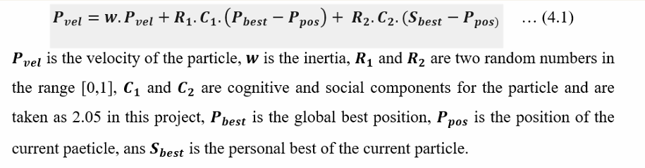
Each particle has its own velocity, which is updated based on the following equation (4.1):

Slide 8

Collision Check for GWO Like PSO, each new position is checked for collisions with obstacles:
No Collision: Continue the optimization process until the maximum number of iterations is reached.
Collision Detected: Re-evaluate and update the position of the wolves as needed, ensuring valid paths are maintained.
Finally, after completing the GWO iterations, the path with the lowest path length is returned as the optimal solution. This path represents the most efficient route from the start point to the end point, avoiding all obstacles

Slide 9
RESULT AND DISCUSSION
Phase 1
The results of this study aimed to show the efficiency of the PSO+GWO concatenated approach with adaptive inertia in path planning from source to destination while avoiding all the obstacles in the search space as compared to the traditional PSO algorithm.
Phase 2
The concatenated approach of PSO and GWO with adaptive weight produced path lengths that were shorter by 2 to 3 units as compared to the traditional PSO. The path produced by the concatenated approach was also smoother with a huge decrease in the number of abrupt and sharp corners

Slide 10
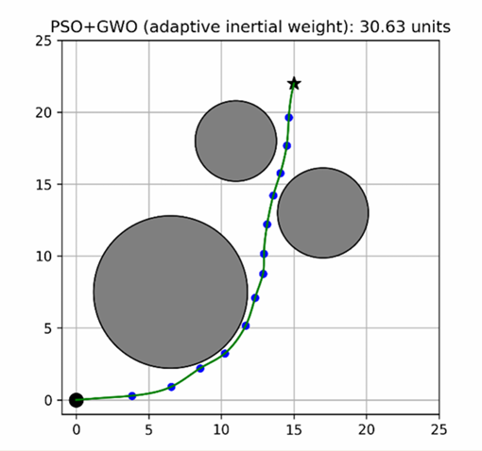
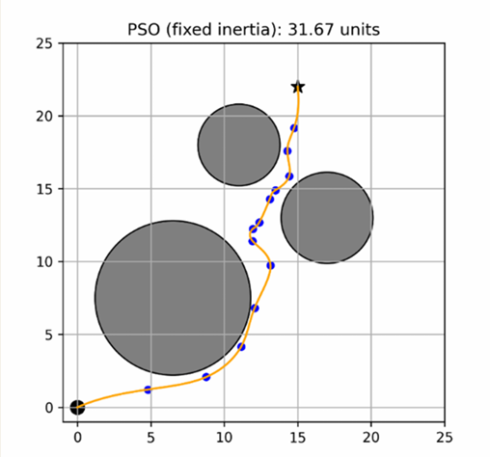
RESULT

Slide 11
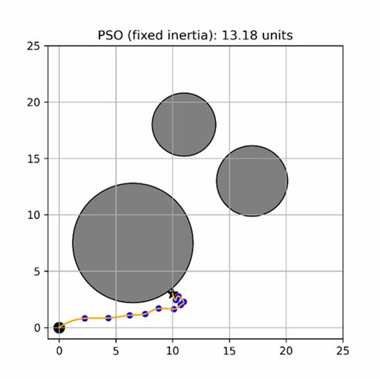
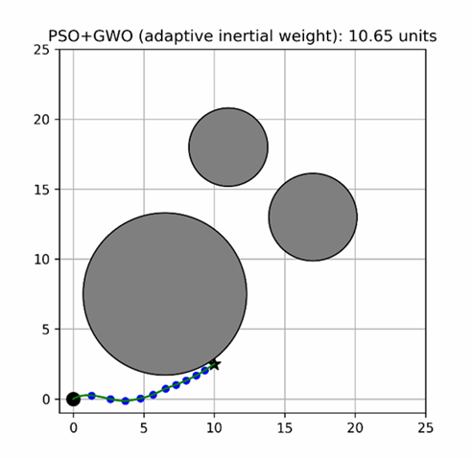
PERFORMANCE ON CORNER CASES

Slide 12

CONCLUSION
This concatenated approach of optimization is very useful as it makes full use of both these algorithms, which although work in similar ways, have their pros and cons and when used together, yield much better results. The findings of this study provide the insight that the concatenated approach of PSO with GWO along with adaptive weight adjustment performed better than the traditional PSO as well as some other methods with different adjustment techniques.

Slide 13
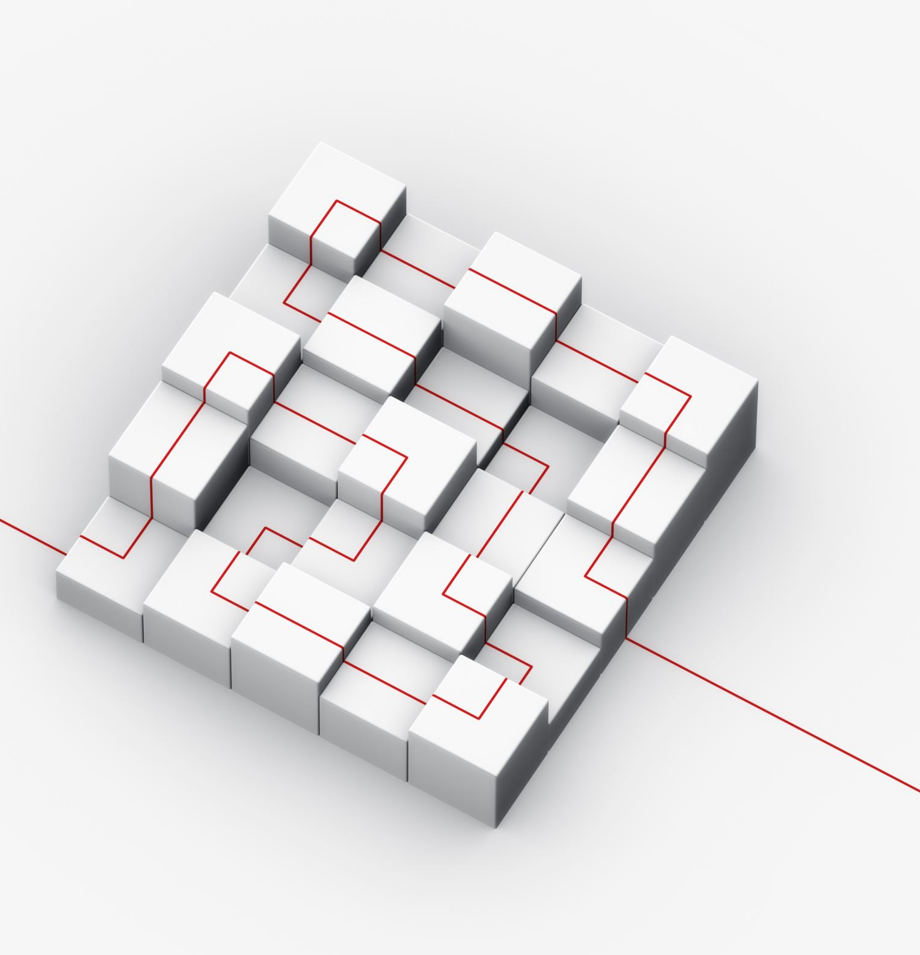
FUTURE WORK
Incorporating dynamic obstacles:
Add obstacles that move over time to simulate more realistic environments.
Implementing real-time adjustments:
Enable the algorithm to adjust paths instantaneously in response to environmental changes.

Slide 14
REFERENCES
[1] K. Hao, J. L. Zhao, B. B. Wang, Y. L. Liu, and C. Q. Wang, "The application of an adaptive genetic algorithm based on collision detection in path planning of mobile robots," Computational Intelligence and Neuroscience, vol. 2021, 2021.
[2] Z. Zhang, Y. Wan, Y. Wang, X. Guan, W. Ren, and G. Li, "Improved hybrid A* path planning method for spherical mobile robot based on pendulum," in International Journal of Advanced Robotic Systems, vol. 18, no. 1, 2021.
[3] C. Miao, G. Chen, C. Yan, and Y. Wu, "Path planning optimization of indoor mobile robot based on adaptive ant colony algorithm," Computers & Industrial Engineering, vol. 156, pp. 107230, 2021.
[4] R. Sarkar, D. Barman, and N. Chowdhury, “Domain knowledge based genetic algorithms for mobile robot path planning having single and multiple targets,” Journal of King Saud University Computer and Information Sciences, vol. 34, no. 7, 2022

Slide 15
Thank You

